Slide 1

Database project: SAP HANa
Using dbSchema, Entity relationships, creating tables, and Data reports

Slide 2

Continuous improvements
We are making changes for continuous improvement

Slide 3
How does this process work?
How is the data actually used in this process

Slide 4
DbSchema
SAP HANA
.Net App Report

Slide 5

Database project includes
DbSchema – creating the entity relationships
SAP HANA – DATA STORAGE & RETREIVAL
.NET App – input + then request data for reports

Slide 6




Three components of database process
SAP HANA Database
DbSchema - ERD
.Net App

Slide 7

Three components of database process
SAP HANA Database
DbSchema - ERD
.Net Appp
Input Data and export Report
Create the Entity Relationships

Slide 8

Three components of database process
SAP HANA Database
DbSchema - ERD
.Net App
ERD file is created & printed
.pdf file is created and printed
Validates schema
Input Data and export Report
Create the Entity Relationships

Slide 9
.NET app: Input + request data for reports
The templates for the report(s)

Slide 10
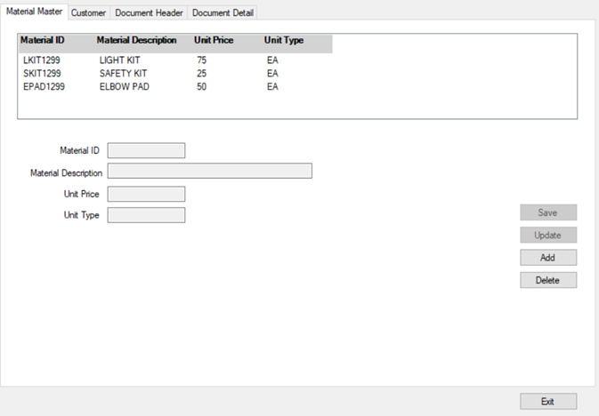
Template 1 – material master

Slide 11
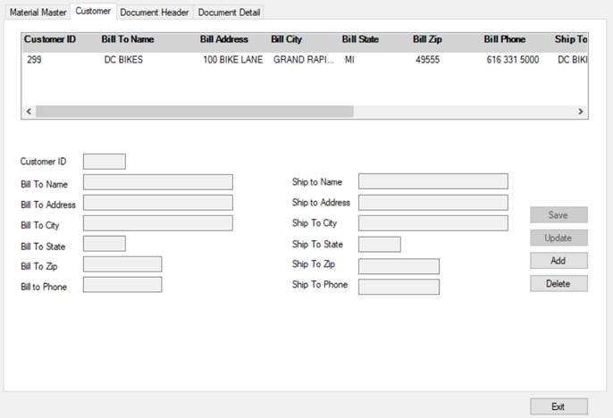
Template 2 – customer master

Slide 12
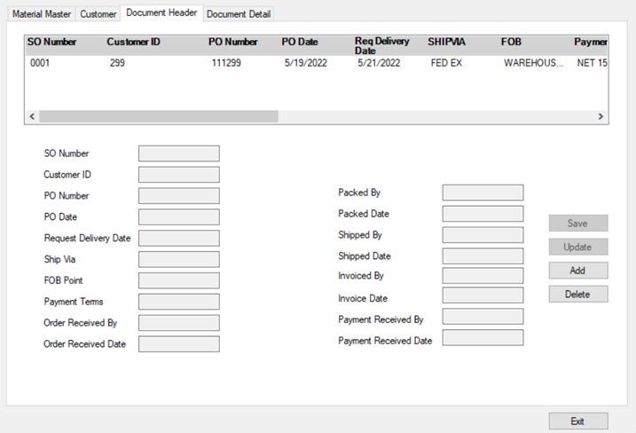
Template 3 – document header

Slide 13
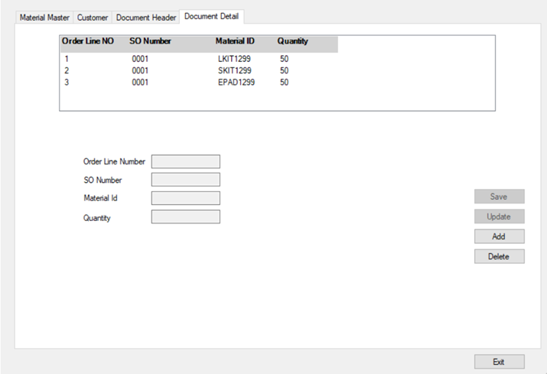
Template 4 – document detail

Slide 14
Two deliverables for the project
PDF (file) OF ENTITY RELATIONSHIP DIAGRAM (ERD) USING DBSCHEMA
USING UNIQUE ID
File name includes your name, section and ID
.PDF REPORT (file) OF THE DOCUMENT POPULATED WITH THE DATA IN THE TABLES.
WITH UNIQUE ID
File name includes your name, section and ID

Slide 15

Benefits
Instructor guide & tools
Student document
Self –pace learning
Active Participation
Problem solving
High level thinking skills

Slide 16
Thank you
questions

